Slide 1

Connected healthcare infrastructure for Nigeria and Africa.
A care platform connecting families, patients, providers, hospitals, pharmacies, records, payments, and AI-assisted clinical workflows.
Pre-seed funding deck
Raising $500k SAFE
www.imanimed.com

Slide 2

PROBLEM
Healthcare coordination is still fragmented.
Patients need access. Families need visibility. Facilities need operating tools. Today these workflows are disconnected.
For patients
For families abroad
For facilities
Finding trusted care, booking appointments, accessing records, and paying for services is still stressful and inconsistent.
Nigerians in diaspora struggle to coordinate reliable care for parents, children, and dependents back home.
Hospitals, clinics, and pharmacies still operate across manual records, disconnected billing, and limited patient follow-up.
The infrastructure gap
The market does not only need another appointment app. It needs a connected layer for access, records, payments, and operations.
www.imanimed.com
Confidential funding deck

Slide 3
WHY NOW
The timing is right for a connected healthcare platform.
Digital payments, telehealth acceptance, diaspora remittances, AI documentation, and facility digitization are converging.
Payment behavior has shifted
Care is becoming hybrid
Families are cross-border
AI makes records usable
Patients and families increasingly expect digital payments, wallet flows, invoices, and transparent receipts.
Telehealth, home visits, in-house professionals, and facility appointments now need to work together.
Diaspora families already fund healthcare. Imani gives them coordination, visibility, and trusted access.
Scribe, transcription, SOAP notes, and structured records reduce admin burden for care teams.
www.imanimed.com
Confidential funding deck

Slide 4
MARKET OPPORTUNITY
Large market. Focused entry wedge.
Imani starts where payment willingness and urgency are strongest, then expands into facility infrastructure and pharmacy workflows.
TAM
SAM
SOM
Nigeria healthcare access, facility operations, pharmacy workflows, payments, records, and AI documentation.
Urban/private care, diaspora-funded family care, digital-ready hospitals, clinics, pharmacies, and provider networks.
First 24 months: FamilyCare subscribers, in-house coverage, paid facility pilots, and pharmacy/HMS modules.
Large national healthcare spend pool
High-intent digital adoption segment
Path to repeatable ARR
Diaspora wedge
Facility expansion
Network effects
Nigerians abroad already fund care at home; FamilyCare turns that spend into managed, recurring care.
Hospitals, clinics, and pharmacies can adopt one module, then expand into HMS/PMS suites.
Each appointment, prescription, invoice, and record increases platform utility across the care graph.
Sizing basis: Nigeria population scale, healthcare expenditure indicators, remittance flows, and Imani pricing assumptions.
www.imanimed.com
Confidential funding deck

Slide 5
SOLUTION
Imani Health is the operating layer for connected care.
One platform linking the people, workflows, records, and payments required to deliver healthcare reliably.
Providers & in-house professionals
Patients & dependents
Hospitals & clinics
One Connected
Care Layer
Pharmacies
Records, payments, AI
Every care interaction becomes easier to coordinate because access, records, payments, and operations sit on the same layer.
www.imanimed.com
Confidential funding deck

Slide 6
PRODUCT
Full-stack healthcare platform.
Imani can start with one workflow and expand into an integrated care operating system.
Family subscriptions
Provider network
HMS for hospitals
Primary subscriber + dependents, shared quota, reminders, care visibility, telehealth and visits.
Standalone professionals, in-house professionals, scheduling, availability, patient lists, appointments.
Admissions, rooms, beds, EMR, billing, invoices, staff, services, lab orders, prescriptions.
PMS for pharmacies
Payments layer
AI clinical layer
Drug inventory, dispensing, POS sales, prescription fulfillment, purchase orders, revenue history.
Wallets, invoices, Paystack, Stripe, renewal tracking, receipts, refunds, provider/facility settlement.
AI scribe, recordings, transcription downloads, SOAP notes, and documentation support.
www.imanimed.com
Confidential funding deck

Slide 7
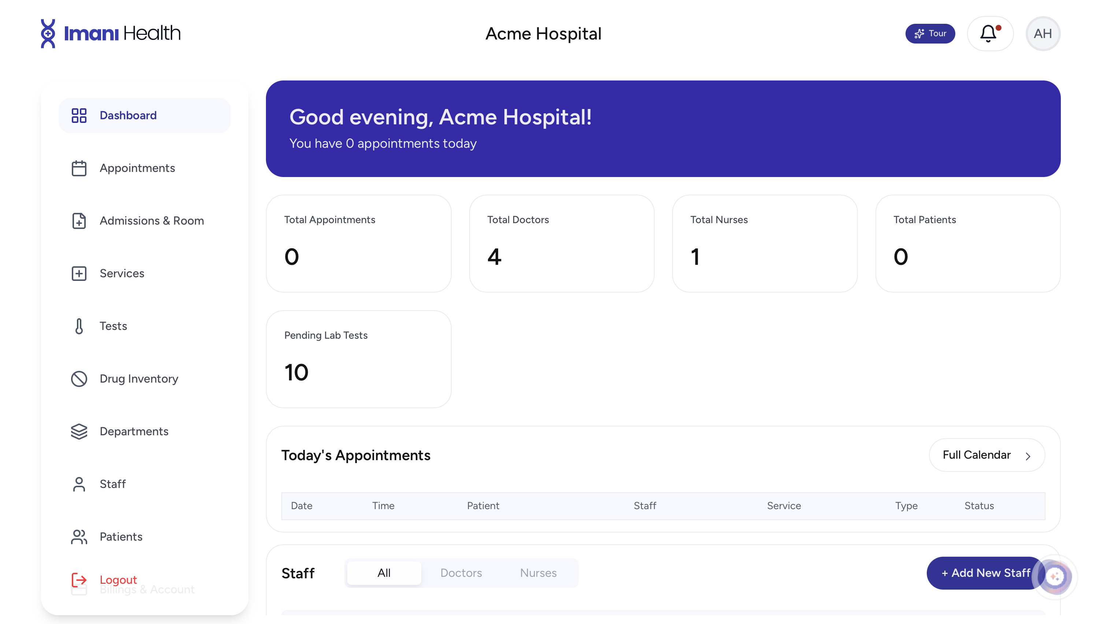
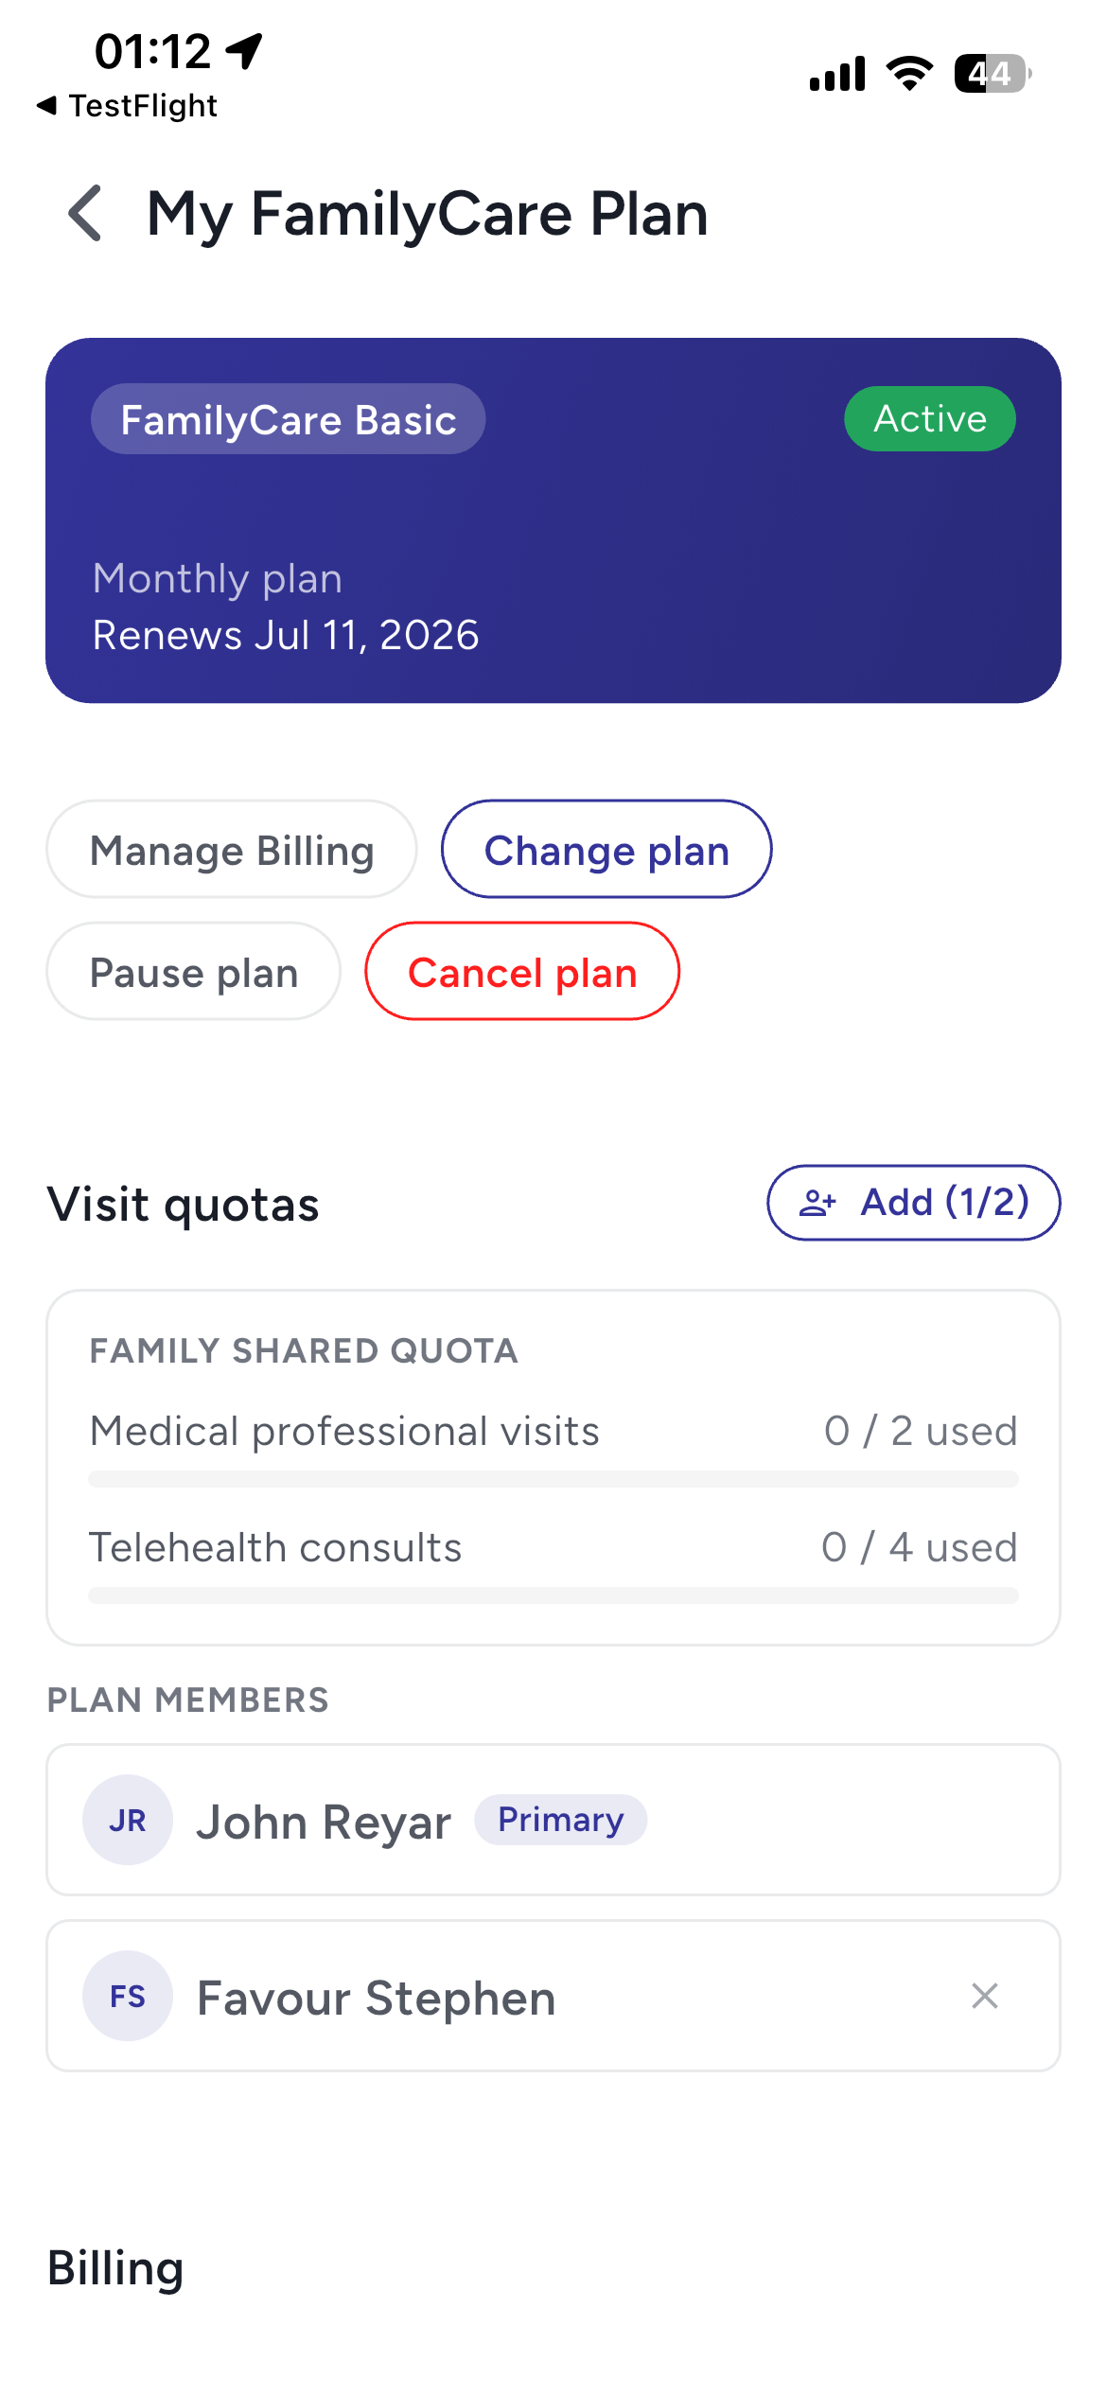
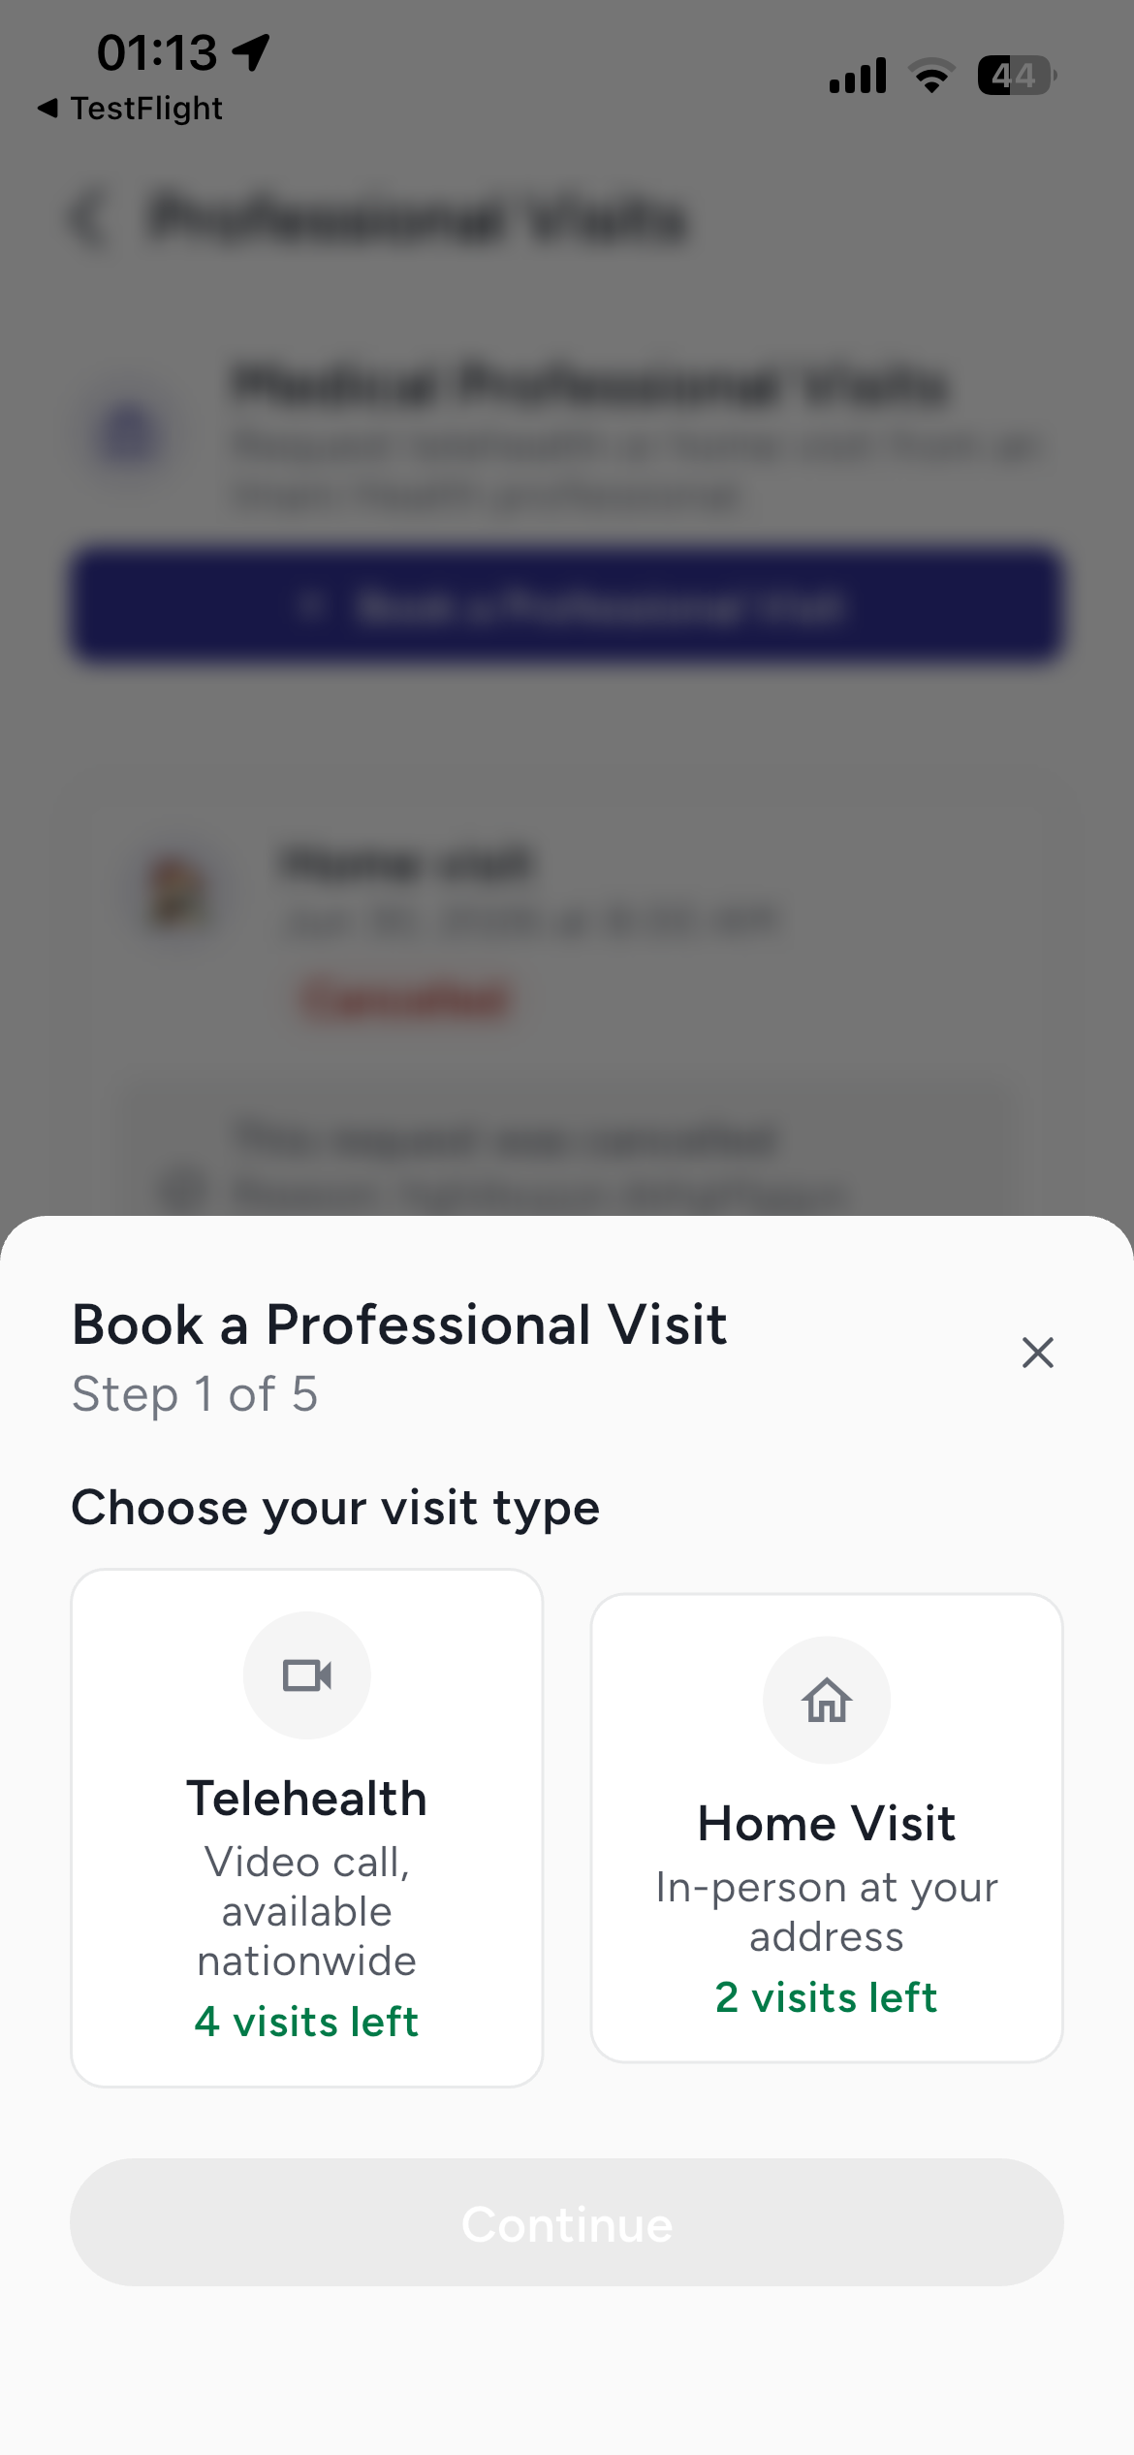
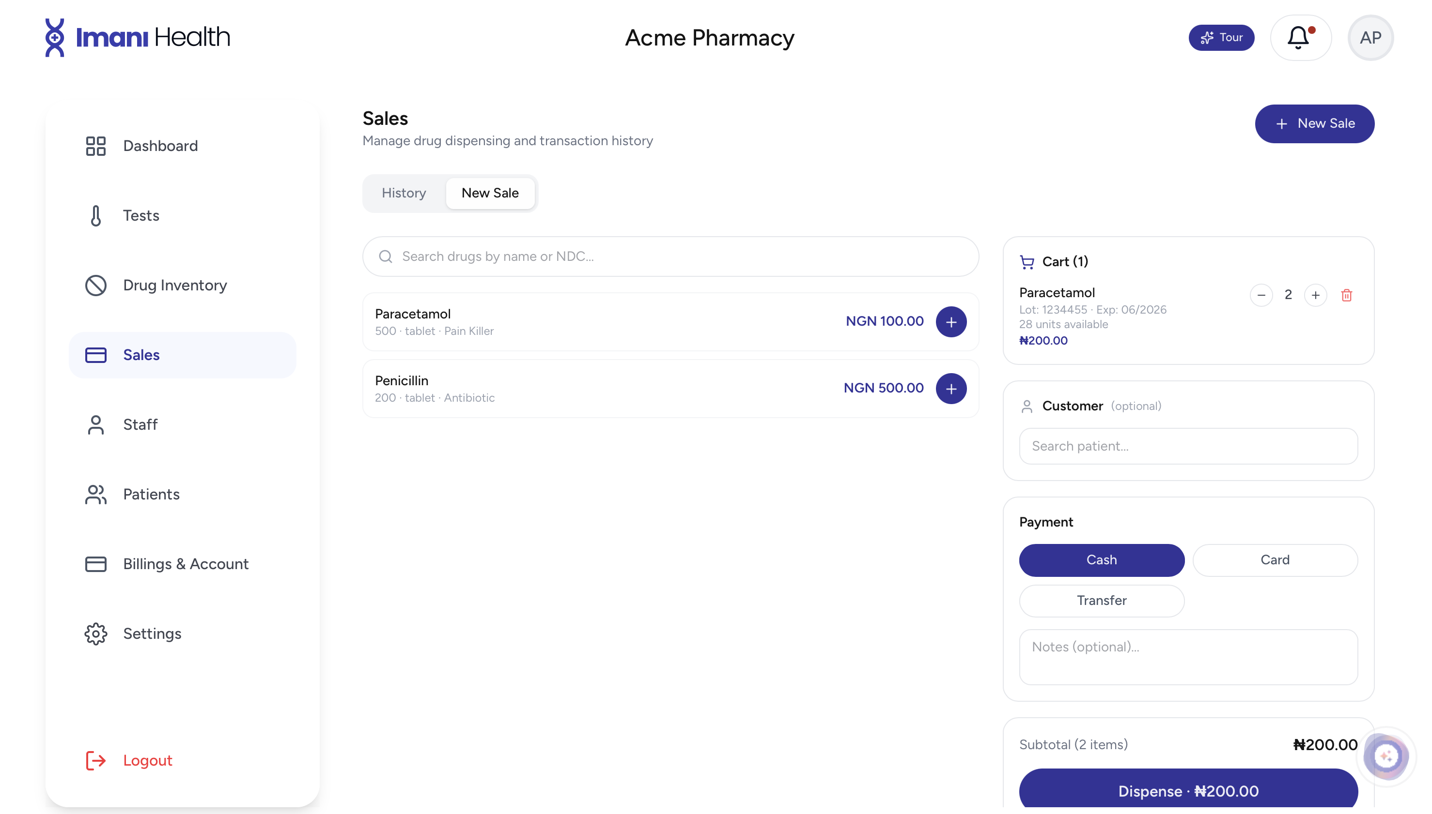
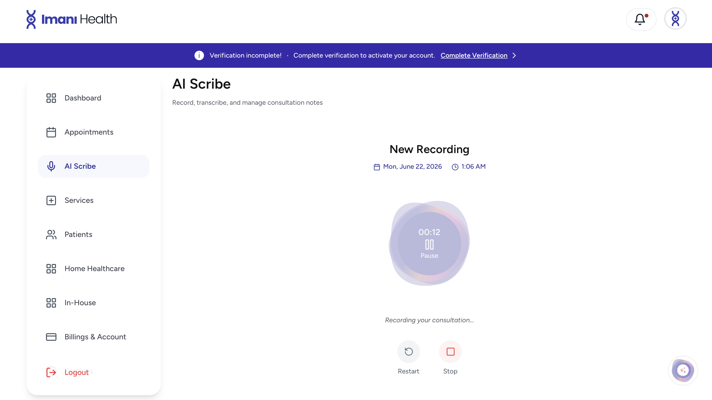
PRODUCT PROOF
Real product surfaces across the care journey.
The platform already spans patient subscriptions, professional visits, hospital operations, pharmacy sales, and AI documentation.
Pharmacy POS
A connected product system for family care, clinical workflows, facility operations, pharmacy, payments, and AI documentation.
FamilyCare
Visit booking
AI Scribe
www.imanimed.com
Confidential funding deck

Slide 8
WEDGE
Diaspora family care is the wedge.
Nigerians abroad already pay for care at home. Imani gives them a trusted way to coordinate and monitor that care.
Primary subscriber
Dependents in Nigeria
In-house professionals
Lives anywhere in the world, pays for a plan, manages dependents, receives care updates, and books services remotely.
Parents, children, siblings, and relatives access telehealth, home visits, records, tests, prescriptions, and follow-up.
Imani-activated doctors, nurses, and pharmacists accept subscriber appointments based on location and availability.
Simple promise: care for your loved ones in Nigeria from anywhere.
www.imanimed.com
Confidential funding deck

Slide 9
ORGANISATIONS
Modular HMS and PMS adoption.
Hospitals and pharmacies can start with one workflow, then expand into a connected operating system.
Standalone modules
HMS suite
PMS suite
Appointments, EMR, billing, pharmacy POS, drug inventory, lab orders, admissions, AI scribe, telehealth, notifications.
For clinics and hospitals: staff, services, appointments, admissions, rooms/beds, prescriptions, lab orders, invoices, patient records.
For pharmacies: inventory, drug sales, dispensing, prescription workflows, purchase orders, stock alerts, sales history, receipts.
Expansion path: one module -> department workflow -> facility suite -> multi-branch network.
www.imanimed.com
Confidential funding deck

Slide 10
BUSINESS MODEL
Revenue compounds across the network.
The model combines recurring software, family subscriptions, transaction revenue, and enterprise partnerships.
FamilyCare plans
Facility SaaS
Monthly and annual subscriptions for primary subscribers and dependents.
Hospitals, clinics, and pharmacies pay for HMS/PMS modules and suites.
Transactions
Enterprise partners
Payment processing, add-on visits, invoices, wallets, receipts, and settlement flows.
Hospital groups, employers, HMOs, pharmacy chains, and care networks.
www.imanimed.com
Confidential funding deck

Slide 11
GO TO MARKET
Start narrow, then expand.
The GTM focuses on channels where trust, urgency, and payment willingness are already present.
1
2
3
4
Diaspora family care
Provider supply
Facility pilots
Network expansion
Acquire subscribers who need trusted care coordination for dependents in Nigeria.
Activate in-house and standalone professionals around subscriber demand and location coverage.
Onboard clinics, hospitals, and pharmacies through high-value workflows like billing, appointments, pharmacy, and EMR.
Use records, payments, prescriptions, and referrals to connect families, providers, facilities, and pharmacies.
www.imanimed.com
Confidential funding deck

Slide 12
COMPETITIVE LANDSCAPE
Imani connects the care loop.
The opportunity is not only digitizing one workflow. It is connecting access, records, operations, pharmacy, payments, and AI documentation.
Category
What they solve
Where Imani wins
Booking / telehealth apps
Patient access and virtual consults
Access plus records, prescriptions, payments, in-house professionals, and follow-up.
Hospital software
Facility administration
Facility tools connected to patients, families, pharmacies, providers, and payments.
Pharmacy POS / inventory
Drug stock and sales
Inventory plus prescriptions, dispensing, patient records, receipts, and facility workflows.
Payment tools
Checkout and collections
Payment tied to appointments, invoices, subscriptions, wallets, renewals, and settlement.
Positioning: the connected operating layer for patient access, facility operations, pharmacy workflows, payments, and AI clinical documentation.
www.imanimed.com
Confidential funding deck

Slide 13
DIFFERENTIATION
Imani is not a single-point solution.
Most tools solve one workflow. Imani connects the workflows that healthcare actually depends on.
Alternative
Limitation
Imani advantage
Booking apps
Appointments only
Imani links booking to records, billing, provider supply, and follow-up.
Hospital software
Facility-only workflows
Imani connects facilities to patients, families, pharmacies, and remote care.
Pharmacy tools
Inventory or POS only
Imani links prescriptions, drug inventory, dispensing, sales, and patient records.
Telehealth apps
Virtual care only
Imani supports telehealth, home visits, in-house professionals, and facility care.
www.imanimed.com
Confidential funding deck

Slide 14
ROADMAP + MILESTONES
$500k funds the next 12 months of proof.
The goal is not to build endlessly. It is to prove paid adoption, care quality, operational reliability, and repeatable growth.
0-3 months
3-6 months
6-9 months
9-12 months
Stabilize
Launch pilots
Measure
Prepare seed
Production readiness, QA, security, admin tooling, payment/renewal reliability, notification coverage.
FamilyCare launch, first in-house professional coverage zones, facility/pharmacy pilots, customer support playbooks.
Retention, utilization, renewal success, facility module adoption, provider coverage, care operations metrics.
Repeatable GTM channels, paid ARR base, stronger compliance posture, partnerships, seed-ready metrics.
Success gate: validated FamilyCare demand + paid facility pilots + reliable payments/renewals + measurable repeat usage.
www.imanimed.com
Confidential funding deck

Slide 15
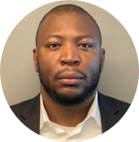
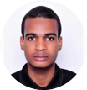

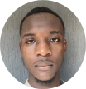
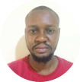
TEAM
Team building inside the market.
Imani combines product vision, platform engineering, design, mobile execution, and AI capability with direct market feedback from Nigeria.
Achile Akoh
Mohammed Abdulhakeem
Favour Stephen
Ibrahim Mohammed
Nabil Sani
CEO & Founder
CTO
Product Designer
Frontend / Mobile
AI Engineer
Nigeria / USA
Abuja, Nigeria
Abuja, Nigeria
Abuja, Nigeria
Abuja, Nigeria
Vision, investor relations, product strategy
Platform architecture and engineering leadership
UX, product design, user research
React Native and web platform execution
AI Scribe, language models, transcription
Cross-continent execution: strategy and investor access in the US, with product, engineering, AI, and market feedback embedded in Nigeria.
www.imanimed.com
Confidential funding deck

Slide 16
THE ASK
Raising $500k to reach paid pilots and repeatable growth.
A focused pre-seed SAFE to harden the product, launch commercial pilots, and validate the go-to-market engine.
$500k
Use of funds
12-month milestones
Product 40%
GTM and pilots 30%
Compliance and security 15%
Operations and support 15%
Launch pilots
Validate FamilyCare subscriptions
Activate in-house coverage
Measure retention and repeat usage
Prepare for seed round
Pre-seed SAFE
Goal: prove commercial repeatability before scaling across Nigeria and then broader African healthcare markets.
www.imanimed.com
Confidential funding deck

